Slide 2
The Pearl Corporate Culture & Change team

Slide 3
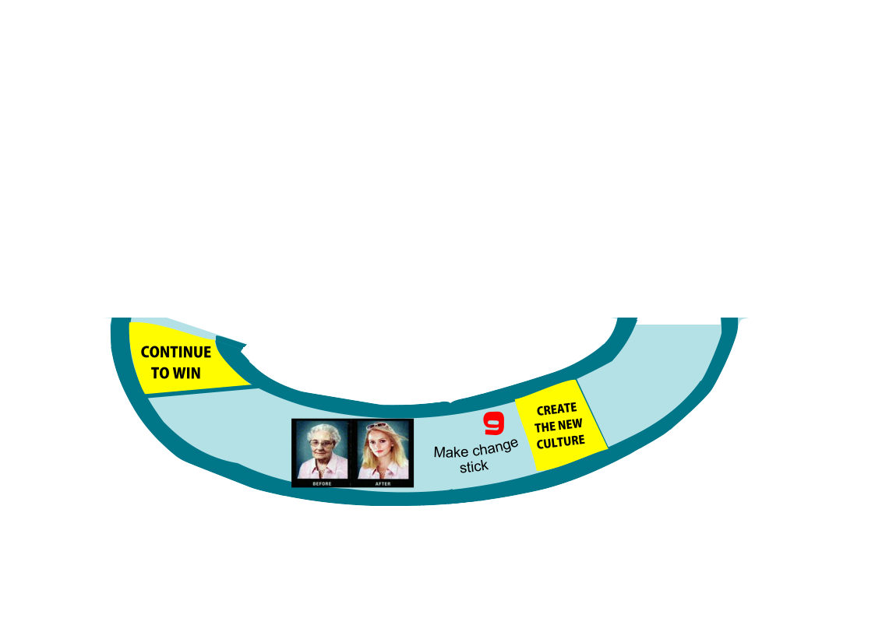
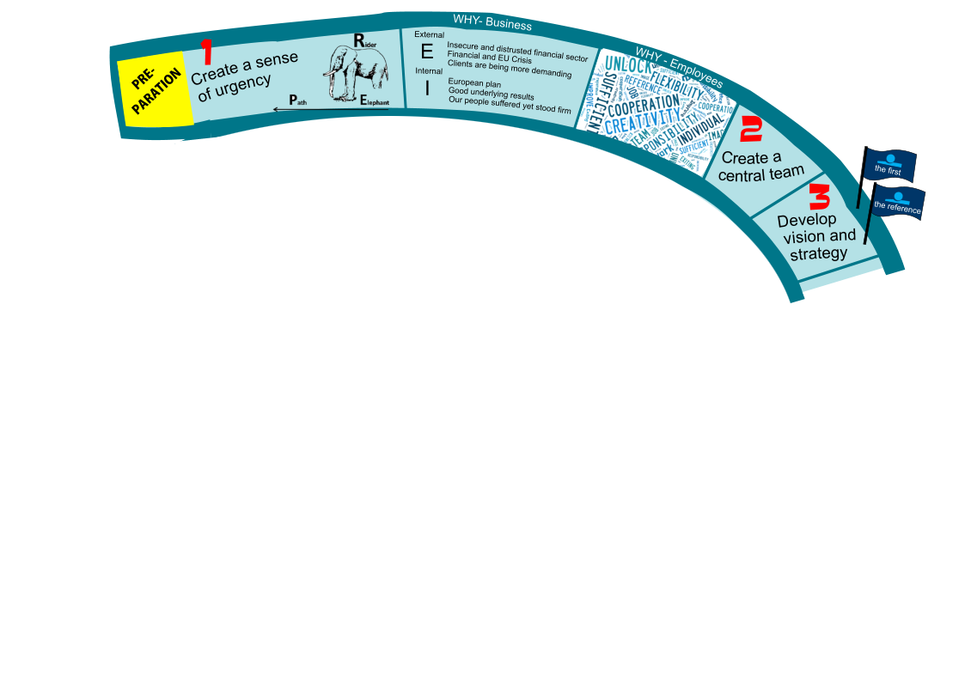
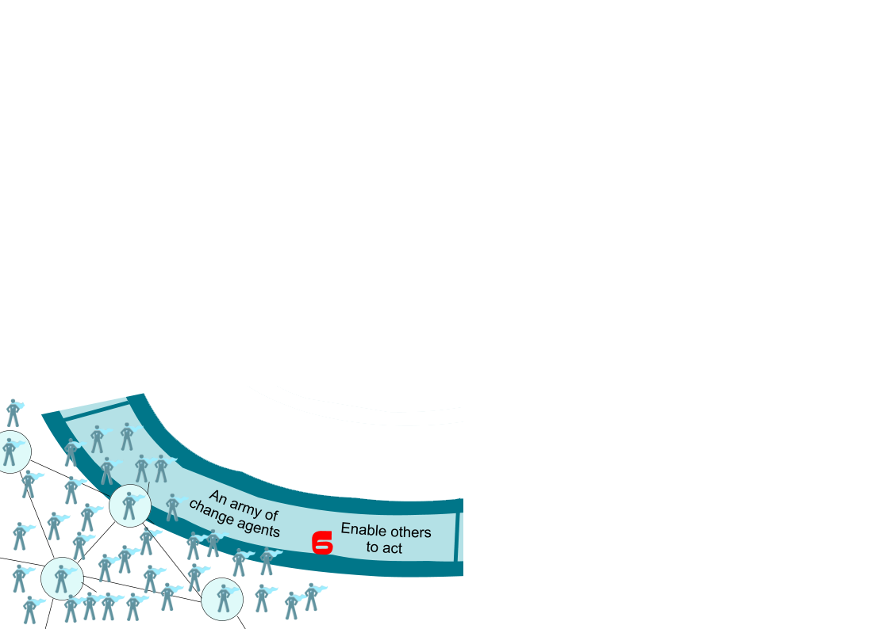
Let us take
you on a
Pearl journey

Slide 4
When does Pearl start changing things?

Slide 5
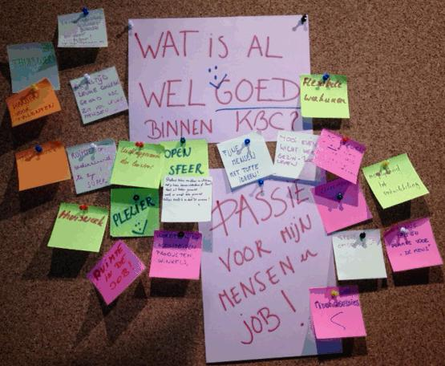
The voice of the floor can be inspiring ...
I want to join /+/ Finally! /+/ Think positive. /+/ Time for a change /+/ There are many opportunities /+/ I like the buzz it creates /+/ My management is actually doing stuff /+/ Changing culture can be fun!
5

Slide 6
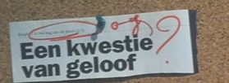
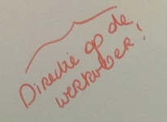
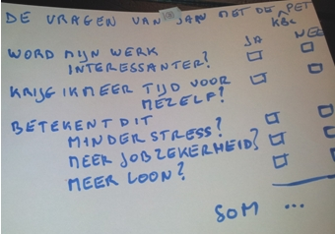
… but also very real.
I don't know where to start /-/ We are already working Pearl /-/ Another name, another strategy. What's different? /-/ I'm still waiting on a move of top management /-/ I haven't seen anything at our work floor yet /-/ It's only fun & communication
6
Notes:
I don't know where to start
We are already working Pearl
Another name, another strategy. What's different?
I'm waiting for a move of top management
I haven't seen anything at our work floor yet
It's only fun & communication

Slide 7
What is the Pearl philosophy?
Purpose drives people.
Engaged people lead to better results.
Proud people go a mile further.
Focus on the positive leads to better and more creative results.
Human aspect is key. Pearl needs to be embraced.
Story telling to generate positive vibes.
No large central change program, local initiative

Slide 8
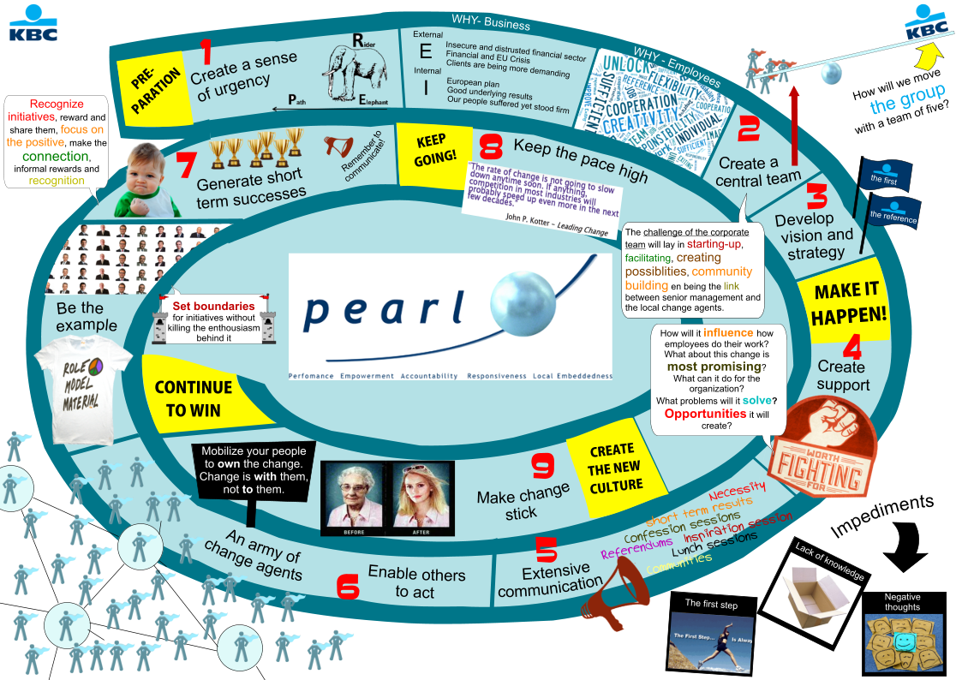

Slide 9
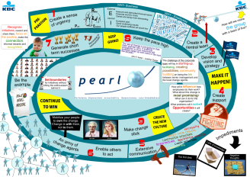
What is change?
Change is a process. Change is a journey.
Change is head and heart, not just head.
Every change has a why that needs to be kept alive.
Change starts with understanding. Help everybody understand.

Slide 10
Change needs support
Change is exploration, thinking, making mistakes, learning, testing, accepting, supporting and struggling.
Change is doing more of what we were doing good.
Its success depends on being accepted by our colleagues.
Mobilise individuals to become owners of change. Change is with them, not to them.
Set boundaries for initiatives without killing the enthusiasm behind them.
Change starts by creating support.

Slide 11
If we need to set the group on fire, communities are our oxygen
When breathing new life into the group, deploy change agents throughout the organisation to exhibit PEARL behaviour and instill trust.
Involve many change agents, not the usual few appointees.
Change starts with distributed leadership.
The Corporate Pearl Culture & Change Team will support and facilitate.

Slide 12
Change is contagious
Overcome the illusion of change when processes, training and structure are the only things being changed.
It's behaviour that changes culture, not the other way around.
Our leadership needs to role model the expected behaviour.
Our leadership needs to orchestrate the pull of connected individuals.
Change starts with leadership.

Slide 13
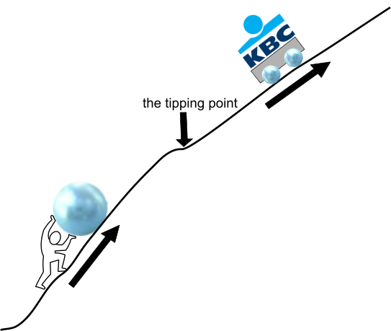
Change alone is unchanging
Let's change the culture one small step at a time.
Emphasise the opportunities that are created.
Recognise initiatives, share and reward them.
Share positive stories.
Behaviour will change behaviour.
Change starts with positive experiences.

Slide 14
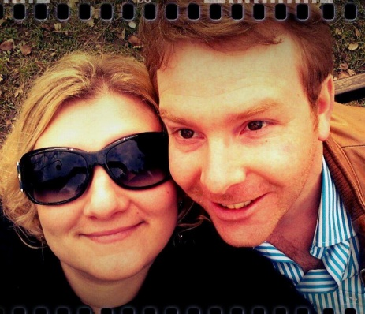
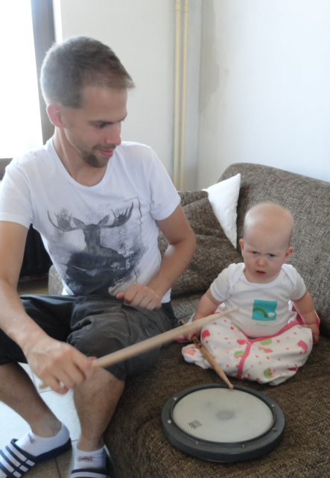
Who is the Pearl Corporate Culture & Change team?
Sofie Blockx
Koen Vingerhoets
Karel Nijs

Slide 15
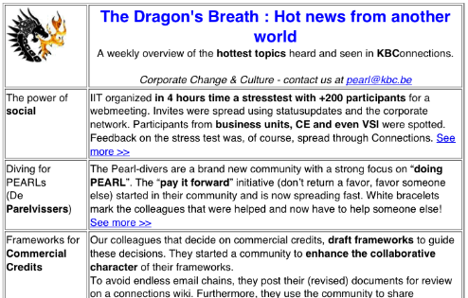
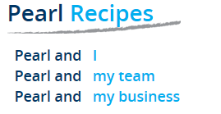
What are they doing?
Spreading the word
Helping leadership
Helping you
?
Enabling
Facilitating
Creating opportunities
Making tangible
Notes:
Het overlapt!

Slide 16
Focus of the Corporate Pearl Team
Animate a Pearl Change Community
Animate a Pearl Change Leader Community
Pearl Leadership track for GM & SGM
Steer Central Pearl Communication
Bringing People together within the entire KBC group to exchange best practices around change
Bringing SGM’s together over the KBC Group in smaller groups (already started in November)
Will be base of Pearl Ambassadors
BU/SGM hook-in
Brainstorms with CMM to launch in big campaign
Launch in March
Adapt Vlerick Program to Pearl
KBC Connect!
Theme months
Expectation that all BU will take own initiatives for this
Steer Pearl Communication - territory Belgium
Develop a corporate large Pearl community initiative
Create and manage the pearl asset
Deliver advice on demand of SGMs on local Pearl change initiatives
Eg. The Pitch II
Pearl menu & recipes
Already started in a number of entities
Fast track specific actions for BU Belgium
Go for common understanding for all BU on highly visible things
Leadership menu in development with org/PPO
(* Exco 18/12/2012)

Slide 17
Timing & scope – Culture & Change
SGM Level
Business Unit
Corporate
Different approaches already started or in starting blocks
Make it concrete eg. Learning Projects, Awards, BU CEO Communication, bring different pearl people within BU together , tracks with CEO, SGM & GM
Theme months - high-level offer – opt-in for BU & SGM
Opt-in Management Track (co-creation mode)
Summit
Group wide Culture initiative
Pearl Recipes
Pearl ‘Ambassadors’
Pearl Change Leader Community (on and off line)
January
March
May
Jul
October

Slide 18
What drives them?
The goal of the Pearl Corporate Culture & Change team is
to (help) make Pearl more tangible for the work floor
to stimulate the cultural change that Pearl needs
to provide a framework where behavior can be developed into a new corporate culture

Slide 19
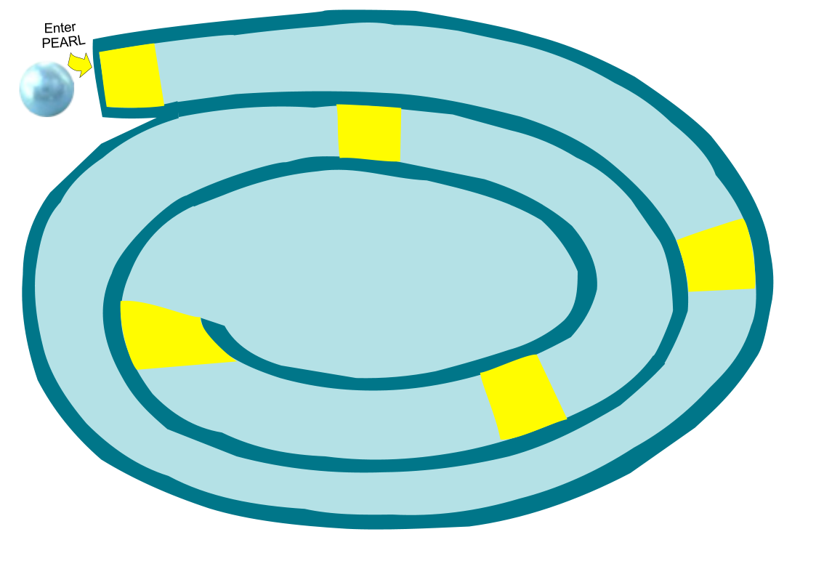
Let us enjoy
our Pearl journey
together!

