Slide 1





Orientation
-A summary
We will show you the way to success
We Will show you how to build your organization

Slide 2
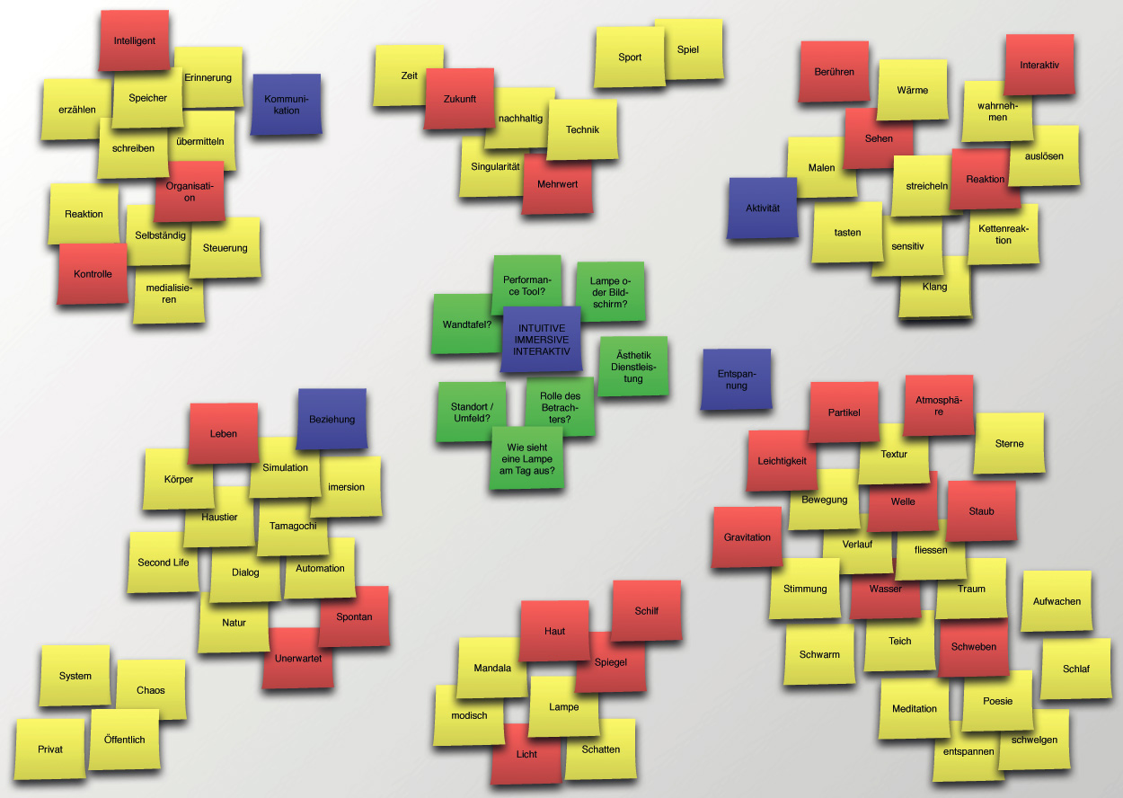
Expectations
Notes:
Facilitator asks participants to write down the questions on post-it notes that you hope to have answered at the end of this orientation (one question per post-it note)
Facilitator groups related questions on board and adds label to related question (e.g., “Skopos Offerings”)
Facilitator sets expectations of which questions will or will not be answered during orientation, as well as where they can find the answers to the questions that will not be answered
Facilitator comprehensively explains objectives of orientation (see above) as well as the agenda for coming days and welcomes feedback

Slide 3

Objective
To help new members feel, understand, and experience the organizational context that will allow the release of their full potential

Slide 4

Ideal Outcomes - Emotional
Relate Skopos’ missionary vision
Unique team culture,
Family-like atmosphere
Comfortable enough to express individuality.

Slide 5

Ideal Outcomes - Intellectual
Create concrete understanding of philosophical assumptions/foundations
Operational model
Strategic challenges
Individual/organizational expectations.

Slide 6

Ideal Outcomes - Behavioral
Contribute to culture creation
Offer input/solutions to organizational challenges
Proactively seek opportunities for immediate contribution.

Slide 7
Agenda
Day 1
Expectations
Day 2
The History
Day 3
The Challenges
The Vision
The Model
The Guidelines
The Initiatives
The Development Initiative
Adding Immediate Value
Introductions
The Culture
The Offerings

Slide 8

Getting to know Each Other
Name
Little know fact about me
Hobbies/Interests
Likes most in life
Dislikes most in life
Happiest Moment
Single hope
Favorite movie
Favorite type of music
Favorite thing to do in the weekend
One word to describe me
Notes:
Have the participants interview each other

Slide 9

Reach Out
Notes:
Using the Google Spreadsheet, randomly assign 3 to 5 skoposians to each inductee to call, interview, and report back to the team. The facilitator can also set a target for individuals to have lunch/dinner with at least 1 skoposian by the end of the week.

Slide 10




Our Mission

Slide 11
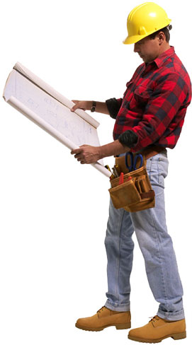
Agenda
  Core Motivations
  Current reality
  The SKOPOS Mission
  Is there a link?
  Challenges
  What’s next?

Slide 12
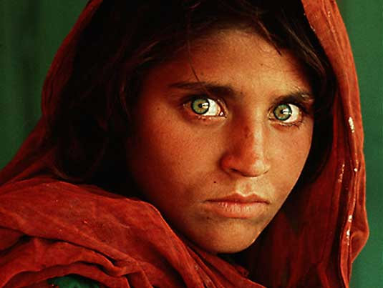
Your Core Motivation
I come to work each day because ___________
Notes:
Core motivation method excercise

Slide 13
Consolidating our motivations

Slide 14
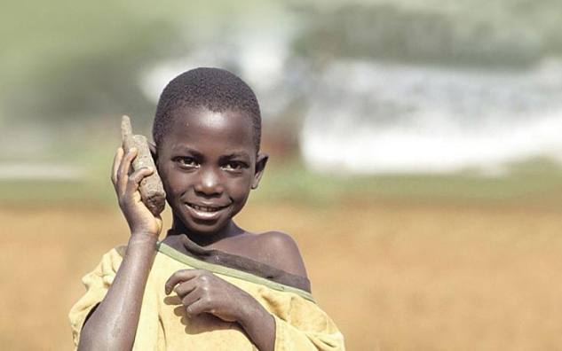
Current Realities
What characterizes organizations within the developing world?

Slide 15
Current Realities
Weak Educational System: few professionals
Low Leadership and Managerial Capacity
Old Leadership Style: Authoritative
Weak Businesses support infrastructure
High reluctance to change due to basic needs insecurities

Slide 16
The SKOPOS Mission
Develop managerial capacity
Develop local labor capacity
Change business philosophy in the region
Change leadership philosophy in the region
Participate in developing nations
Collaborate with organizations to attain their visions

Slide 17
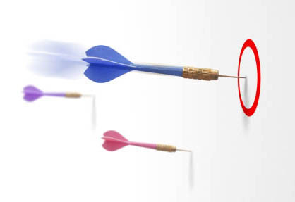
Where is the link?
Aligning
your
mission to
SKOPOS

Slide 18


The Model

Slide 19
Starting point
Skopos is a model based consulting company
Model influencing the initial design of SKOPOS
Changes and developments in SKOPOS as it grows are judged against the model
Serious deviations of the model would result in nothing short than the demise of the company

Slide 20
SKOPOS model
Our Model
Set of beliefs & assumptions of human behavior
Reflected in convictions & perceptions of our field & industry
Translated into strategic choices
Resulting in our Internal Org. culture & consulting mode & tools

Slide 21
Institutionalization
Mature & Align
The Idea
The People
The Organization

Slide 22
The test of operations
The model is put to work through arrangements and actions on the ground shaping the daily behavior of the company internally and externally
A key test of any model is
  When operationalized, does it live up to its ideals and key choices
  Does the company proceed effectively to achieve its mission and targets

Slide 23
Our experience
Significant delivery and fast growth
A rich journey of maturing the model and the team
Issues and questions re our operations
  Internally within SKOPOS
  Externally when delivering services to our clients

Slide 24
SKOPOS model

Slide 25
The competing common model (Model B)
Core concepts/ choices/ assumptions
People are rational beings, maximizing utility, going after their individual material (and other aspects of) well being
They perform better when they
  know clearly what to do
  know clearly the consequences of their behavior

Slide 26
The competing common model (Model B)
Core concepts/ choices/ assumptions
When given much space, people
  get confused due to ambiguity
  engage in unnecessary conflict over roles and rewards
  show signs of abuse (work less, take more, etc)

Slide 27
The competing common model (Model B)
Core concepts/ choices/ assumptions
People learn and grow better when their learning is systematic and cumulative
  Hence, they accumulate credentials as they go through this systematic process (academic degrees, years of experience, etc)

Slide 28
The competing common model (Model B)
Core concepts/ choices/ assumptions
The best way to organize work is to create structures in which
  people know clearly what to do: less ambiguity/ more focus
  there is a respected, differentiated hierarchy of who tells whom what to do
  credentials are the basis of legitimate advancement in that hierarchy

Slide 29
SKOPOS model (Model A)
Core concepts/ choices/ assumptions
People have enormous human potential
People realize more of their potential as
  They believe in higher missions
  Obstacles are removed from their way, among the most significant of which:
    Lack of trust in their judgment or ability (particularly self doubts)
    Inadequate knowledge of the challenges they face in attempting to achieve these missions, or the tools they have at their disposal

Slide 30
SKOPOS model (Model A)
Core concepts/ choices/ assumptions
People learn and grow in unique ways:
  Complex process of interaction between
    Individual inclinations, abilities, values, attitudes, histories, etc.
    Setups offering opportunities and challenges
    Events and experiences (diverse enough to look random)

Slide 31
SKOPOS model (Model A)
Core concepts/ choices/ assumptions
Hence, people grow in leaps
Accumulate their own wisdom
Influence each other’s learning
  Creating rich communities of
    Shared visions/ models
    Diverse individual contributions/ styles

Slide 32
SKOPOS model (Model A)
Core concepts/ choices/ assumptions
Credentials are not necessarily good predictors of performance
Energy, wisdom, potential are much strongly correlated with performance

Slide 33
SKOPOS model (Model A)
Core concepts/ choices/ assumptions
When given space, people
  Explore and find their unique niches
  Own and enjoy what they do
  Grow the most
  Align their minds, souls and actions

Slide 34
Management model
Hence, need to apply a management model that achieves the following:
  Realize as much human potential, release as much human energy, remove as many obstacles as possible
  Focus this energy on delivering highest levels of performance/ quantity and quality (creativity/ ownership/ teamwork, etc)
  Focus this collective performance on achieving the higher mission in the most effective ways possible

Slide 35
Management model
By inverse, the management model will have failed if:
  People experience minimum engagement, exert little energy, realize little potential
  Energy wasted fighting obstacles, diluted focus on performance (common symptoms: frustrations, defensive attitudes and/ or ego rides related to self doubts and insecurities, low effectiveness)
  Lose sight of why they work, what their roles mean in a larger scheme of things, little contribution to the realization of a mission (change/ development, etc)

Slide 36
Management model
Measuring success of management model:
  Not an all or none approach
  No organization will exhibit 100% success on these chosen criteria (not 100% of people, time, issues, etc.).
  Questions are: what is the prevailing pattern & what is the trend? (a journey rather than a destination)

Slide 37
Models A & B
Model B generally assumes
  a linear systematic world occupied by relatively simple, utilitarian, clarity seeking people
Model A generally assumes
  a non linear world occupied by complex, multiple dimensional, mission driven people

Slide 38
Models A & B
Model B focuses on
  controlling people choices and actions (so collectively they can achieve desired outcomes with minimum waste/ noise)
Model A focuses on
  releasing human energy (so unrealized potential of people can be explored and realized)

Slide 39
Models A & B
Reality of human life in organizations: a not very neat display of both models, and many other models
  Models are abstractions of realities. Models don’t replicate every piece of reality, they are choices people make of what elements of that reality to focus on, and how to relate these elements together, hence characterizing human behavior in certain chosen ways
  Sharp contrasts between Model A and Model B is clearly a simplification, one that is meant to emphasize a choice rather than to exhaust reality

Slide 40
Why this choice for SKOPOS?
Why lean towards Model A versus Model B?
  Historical roots
  Drives to change and reform, to challenge status quo
  Beliefs about profession, industry, and field

Slide 41
Models A & B
Can we use ideas/ approaches/ tools commonly used within one model while adopting another model?

Slide 42
Models A & B
  We can adopt many approaches and tools to serve our organizational needs
    Should seek diversity and creativity in ideas and solutions
  However, we need to be careful not to design or implement solutions that are not fully aligned with the core of our model

Slide 43
Beliefs about the profession, industry, field
  Management
    Too focused on material optimization
  Management consulting
    Too much model B oriented
  Organizational development
    Too fragmented, sets of tools and interventions

Slide 44
Assumptions about our region
The Region
Huge Unrealized Potential
Little attention to choices, talents and dreams
Skopos & similar firms to inspire significant national and regional development
Notes:
Change the 3rd one to: Zain to inspire significant national and regional development

Slide 45
Assumptions about our region
Challenges
Privatization
Global Competition
Demands for efficiency
Ambitious Vision

Slide 46
Obstacles
Management Teams Lacking Fundamentals
Planning, organizing & control tools
Established practices & traditions
Proper governance
Awareness & application of modern approaches
Organization Cultures Lacking
Focus on performance
Customer orientation
Professional attitudes & norms
Healthy relationships among managers and employees
Opportunities for growth, creativity & enjoyment
Education & Development Systems Producing
Shortage of qualified professionals, e.g., HR & Marketing

Slide 47
Needs
Building Management Capacity
Skill sets
Attitudes
Role awareness & execution
Changing Organization Cultures
Customer focus
Excellence & value addition
Empowerment
Professionalism
Flexibility

Slide 48
Strategic choices/ delivering our services
Working on the soft side of organizations
  Culture as the core of our work
  Hard side complementary
Implementation oriented
  Resident (collaborative consultant mode)
Designing and implementing integrated, holistic change programs

Slide 49
SKOPOS
Roles/Added Value
Spreading awareness of the vision and management philosophy, and reinforcing sense of urgency
Identifying Cultural strong and problematic areas, particularly those needing concentrated efforts:
  values/ spots/Individuals
Identifying and supporting believers and cultural leaders
Advising top management on Culture related issues

Slide 50
SKOPOS
Roles/Added Value (Contd.)
Checking cultural fit of key work processes
  Proposing changes and redesigning processes as needed
Building capacity of management teams, at both the hard and soft sides
Monitoring patterns of individual and team interaction, and building within and cross functional teams
Building HR Capacity (Generalist) (HRD and Line managers):
  Processes and structures
  Skill sets
  HR initiatives and special programs

Slide 51
Domains
Vision
& Strategy
Structure
Culture
Leadership

Slide 52
Vision
& Strategy
Creating & Sharing the Dream
Chartering a Road Map
Releasing/ Channeling Energies

Slide 53
Structure
The ground floor not the ceiling
Facilitating flows of ideas / information
A vehicle for change
Notes:
Pink on white will not show up

Slide 54
Culture
Significant
Clearly defined target culture
Direct and indirect buildup
Vehicle
Creating an organization that embodies leadership values
Defining special rules of conduct/ roles of management/ criteria for advancement
Keeping change at center stage
Notes:
Change color of text

Slide 55
Leadership
Drives all other domains
Main mechanism for change
Not confined to levels or positions
Key qualifiers:
belief in vision and mission
cultural fit
living with change
exerting significant influence

Slide 56
Leadership in SKOPOS
Roles of leaders within this model
  Articulate and communicate the higher mission
  Ignite passion of their teams
  Draw and protect boundaries of behavior that is aligned with the model, leaving a significant room for people’s initiative, creativity, growth
  Consciously develop new leaders (developing leaders is very critical in this model)

Slide 57
Operational Tools
Operational Tools
Performance Management System
Work Assignment/ Delegation/ Work Load
Motivation / Energy
Communication Issues
Decision Making / Enforcements

Slide 58
Operational tools
Performance management system
  Forward looking/ planning oriented/ assessment follows planning
  Tied into larger “business” planning and monitoring
  Highly collaborative
  Core technical objectives and model compliance behavioral indicators

Slide 59
Performance Drivers in Skopos
Coaching
Pushing
Rewarding
Bonding

Slide 60
Operational tools
Performance management system
  Measures agreed to in the planning phase: quantifying the qualitative through a process of approximation
  The individual suggests and follows up on their own performance Individualized/ customized
  Frequent adjustments/ reality checks

Slide 61
Operational tools
Coaching
Pushing
Rewarding
Bonding
Performance management system
  Success of implementing Performance Management System depends on how well we integrate the 4 pillars of

Slide 62
Operational tools
Work assignment/ delegation/ work load issues
  Basis of assignment: model fit in addition to technical/ credential criteria
  Volunteering / functional and cross functional team debates are common practices in work assignments, even when assigned by manager, buy in is key
  Potential leaders/ potential performers are given special developmental assignments

Slide 63
Operational tools
Work assignment/ delegation/ work load issues
  Delegation: easier with the way work is designed in this model, and with roles of managers
  Seen as a developmental exercise not only an offloading technique
  Tool follows the common sequence: identification of delegated tasks, delegating full jobs, clear measures and follow ups, etc

Slide 64
Operational tools
Work assignment/ delegation/ work load issues
  Work load issues: more problematic in this model in the short term
  Resolved in periodical team reviews

Slide 65
Operational tools
Motivating and sustaining high levels of energy
  Motivation is in line with assumptions
  Most common motivational tools are in line with model B: financial in nature
  Motivational packages are more complex in model A

Slide 66
Operational tools
Communication issues
  Frequent communications in more interactive modes
  Embedding “the model” in communications regarding key decisions, policies, etc
  Running communications in ways aligned with the model: two way communication, feedback
  Balancing time pressures of frequent communications with pressing needs of speed of operations

Slide 67
Operational tools
Issues of decision making/ enforcement
  Applying the consultative decision making model
  Understanding/ executing / communicating consequences of behavior within the model
    Leaders of the implementation of the model
    Complying with the model
    Defiant of the model
  Fast growth and more significant leading roles
  Development and slower growth
  Leaving

Slide 68
Common Tools/Skills
Meetings
Dialogue
Observation
Teambuilding
Conflict Resolution
Feedback

Slide 69
Difficulties of implementing the model
Longer spans of time/ higher tolerance
Consistency
High reliance on soft tools
  Operating in emotional domains
  Referring to the larger mission
Slow in maturing/ slow in replication (no easy replicas)

Slide 70
Operational requirements of model
We need to run these operations in a manner that reflects the following elements
  Prevailing positive energy
  Self regulation
  Flexibility and customization
  High level of engagement and interaction of individuals most directly related to issues
  Leaders/ managers are enablers/ supporters/ facilitators
  Full, uncompromising adherence to our culture, internally and externally

Slide 71
Driving Performance

Slide 72
A Brief History

Slide 73
SKOPOS Quick Facts
1
First OD consulting specialist in the Middle East & Africa
2
View OD as a holistic planned participative continuous process
3
First to use the Collaborative Consultant model in the region
4
Our consultants come from all over the Globe with diverse educational, practical, social and cultural backgrounds
5
Blend a global perspective with regional expertise and cultural awareness
6
Operate in more than 14 countries in the Middle East & Africa
Notes:
Could we add in
Point 1: Could you please mention the change management part??
That we are specialized in helping organizations manage major changes occurring and build stronger and more performance oriented cultures
point 4: that though we have international experience we focus on providing it in a customized “locally fit “ way to our clients.

Slide 74
Organizational Timeline
Louis Allen Associates
Skopos Consulting Group
Skopos Louis Allen Middle East
Skopos Louis Allen Consulting
Skopos Consulting

Slide 75
Organizational Timeline
Louis Allen Associates
Skopos Consulting Group
Skopos Louis Allen Middle East
Skopos Louis Allen Consulting
Skopos Consulting
In 1958, Louis A. Allen writes “The Management Profession”
  Based on 3 year study of managers in 150 organizations
Launches Louis Allen Associates
  Served more that 5,000 clients
Allen Management System
  More than 500,000 Managers trained

Slide 76
Organizational Timeline
Louis Allen Associates
Skopos Consulting Group
Skopos Louis Allen Middle East
Skopos Louis Allen Consulting
Skopos Consulting
Founded in 1991 by Tony Tasca
In 2002, Skopos Consulting group acquires Louis Allen Associates
  Name changed to Skopos Louis Allen International
In 2006, Name changed to Louis Allen Worldwide

Slide 77
Organizational Timeline
Louis Allen Associates
Skopos Consulting Group
Skopos Louis Allen Middle East
Skopos Louis Allen Consulting
Skopos Consulting
Established by Dr. Hussein El-Kazzaz in 2002
Best Practices
  International tools and solutions
Best Fit
  Experienced consultants aware of Middle-Eastern Culture

Slide 78
Organizational Timeline
Louis Allen Associates
Skopos Consulting Group
Skopos Louis Allen Middle East
Skopos Louis Allen Consulting
Skopos Consulting
In 2007, Skopos Louis Allen Middle East changes name to Skopos Louis Allen Consulting
Aggressive recruitment and growth in Middle East and Africa

Slide 79
Organizational Timeline
Louis Allen Associates
Skopos Consulting Group
Skopos Louis Allen Middle East
Skopos Louis Allen Consulting
Skopos Consulting
Now known as Skopos Consulting
Launch of the Kuwait Office in Mid 2008
Launch of Kenya office in November 2008
Launch of Dubai expected in February 2009

Slide 80
The Culture

Slide 81
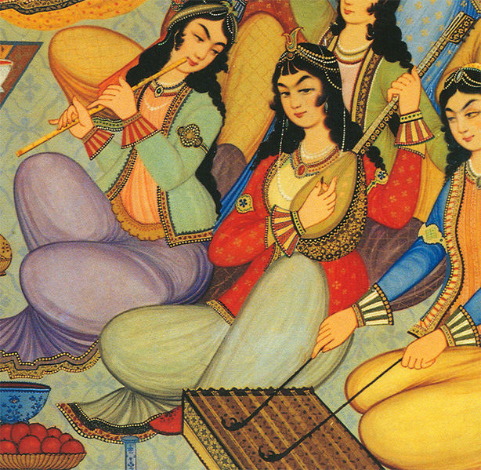
What is Culture?

Slide 82
Definitions
Culture refers to the cumulative deposit of knowledge, experience, beliefs, values, attitudes, meanings, hierarchies, religion, notions of time, roles, spatial relations, concepts of the universe, and material objects and possessions acquired by a group of people in the course of generations through individual and group striving.
Culture is the systems of knowledge shared by a relatively large group of people.
Culture is communication, communication is culture.
Culture in its broadest sense is cultivated behavior; that is the totality of a person's learned, accumulated experience which is socially transmitted, or more briefly, behavior through social learning.
A culture is a way of life of a group of people--the behaviors, beliefs, values, and symbols that they accept, generally without thinking about them, and that are passed along by communication and imitation from one generation to the next.
Culture is symbolic communication. Some of its symbols include a group's skills, knowledge, attitudes, values, and motives. The meanings of the symbols are learned and deliberately perpetuated in a society through its institutions.
Culture consists of patterns, explicit and implicit, of and for behavior acquired and transmitted by symbols, constituting the distinctive achievement of human groups, including their embodiments in artifacts; the essential core of culture consists of traditional ideas and especially their attached values; culture systems may, on the one hand, be considered as products of action, on the other hand, as conditioning influences upon further action.
Culture is the sum of total of the learned behavior of a group of people that are generally considered to be the tradition of that people and are transmitted from generation to generation.
Culture is a collective programming of the mind that distinguishes the members of one group or category of people from another.
Notes:
This is intentionally small and hard to read.

Slide 83

What are your personal values?

Slide 84

How did you get these values?

Slide 85

Values Definition
SKOPOS Core Values
Openness
Client Focus
Love, Care and Closeness
Diversity
Development
Integrity

Slide 86

What can you do to immediately demonstrate the culture?

Slide 87
SKOPOS Beliefs
Personal Family Comes First; People Come First
SKOPOS Is A Family: True Genuine Bond
We Trust Each Others Ability To Self-manage Ourselves; Systems Are Just Guidelines
We Are All Passionate About What We Do
We Are All Positive People
We All Respect, Accept And Adapt Each Others Differences (Diversity)
We Practice Tolerance With Each Other
We Frequently Meet For Alignment And Feedback
We Make Collaborative Decisions
We Are In A Continuous Pursuit Of Excellence & Development
We Meet Frequently And Have Fun When We Gather
Notes:
Point 1: Personal family comes first and our skopos “extended family” comes next. (I just think “people come first” is so cliché’”
Point 2:where are the “very close to each other”part??!!
Could you possibly add another slide with some of our other beliefs??

Slide 88

Story Time

Slide 89
Agenda
Day 1
Expectations
Day 2
The History
Day 3
The Vision
The Model
The Guidelines
The Development Initiative
Adding Immediate Value
Introductions
The Culture
The Offerings
The Challenges

Slide 90
SKOPOS Offerings, Initiatives, Roles & Responsibilities
December 08
We will show you the way to success
We Will show you how to build your organization

Slide 91
Outline
Methodology
Type of Engagement
Collaborative Consultant
Offerings
Clients
Roles
Drives on the ground

Slide 92
SKOPOS Methodology
Implementation/ Interactive Mode
Success:
Transformation
Global Tools/ Local Application
Knowledge Transfer
Notes:
How about a brief explanation of how do we integrate all four ? What is the purple circle “success: Transformation??

Slide 93
SKOPOS Type of Engagement
Long-term Strategic Partnership With Clients: Collaborative Consultant
Building Interventions Around Organization Needs
Integrated Change Programs Across Domains & Levels
Implementation Oriented In Collaboration With Client
Small Volume, Large Margin
Enabling Clients To Acquire The Only Sustainable Competitive Advantage: Competent Empowered Creative Human Resources
Guided By Models, But Developing Customized Solutions
Best Fit Not Best Practice
Notes:
2nd point, could we amend the organization need into org. business needs?
Last point, could we replace human resources with human capital… so no one would take the impression we are HR consultants.

Slide 94
Why The Collaborative Consultant Model
The need to achieve huge business successes by building a unique culture, significantly different than common practices
The relatively weak managerial capacities (skill sets, role perceptions, attitudes and professionalism) in less developed regions
Notes:
I really believe we can add much more to this slide.

Slide 95
Who Are Our Clients?
Large Companies Interested In Culture Change
Large Companies Understanding The Effect Of OD On Their Human Capital
Large Organization With An Overall Change Program Led By An Entrepreneur

Slide 96
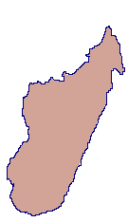
SKOPOS Geographical Spread

Slide 97
Roles & Responsibilities
Management Team
Leadership Team
Development Team
Operations Team
Consulting Team
Model Development
Business Dev. & Finance

Slide 98
Adding Immediate Value

Slide 99

The Journey
The Vision
The Model
The Culture
The History
The Resources

Slide 100
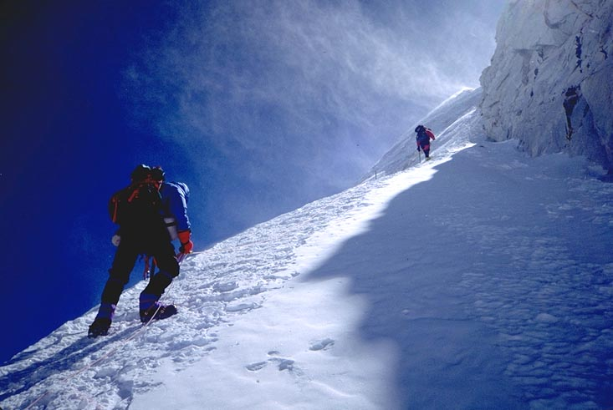
What are challenges may you face in transitioning to the organization?
Notes:
What have been the challenges of your mission

Slide 101

What are the organizational resources/people that could facilitate these challenges?

Slide 102
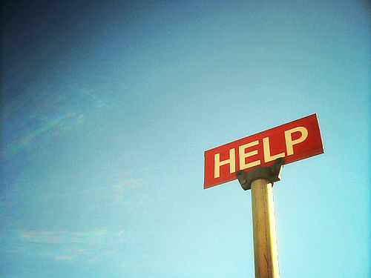

Slide 103


Slide 104
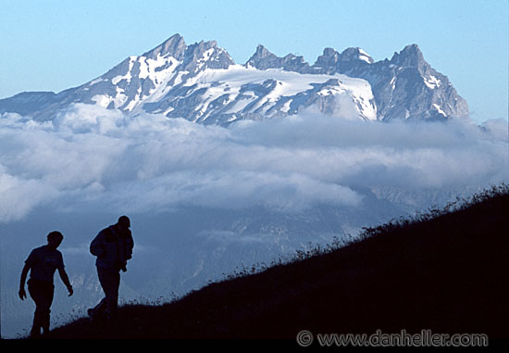
What are the major challenges the organization faces?

Slide 105
SKOPOS Mission Challenges
Find the right customer
Finding believers – finding the right the people
Managing an operation with a unique model
Motivating the people
Selling the offering
Maintaining the culture

Slide 106
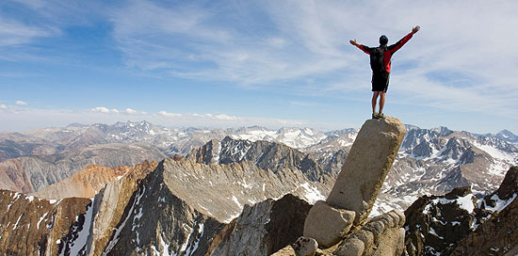
What’s Next?
How can you use your strengths contribute to overcoming these challenges?

Slide 107
Thank you

